Slide 1
Effects of ligand binding to ACE2 and PL-Pro
Jonathan Borowsky, Asa Kalish, and Yisheng Zheng
9/22/22

Slide 2
Questions
What structural factors contribute to the thermodynamics of ligand binding?
Crystal structures provide some insight into enthalpic and hydrophobic effects
Entropic effects on protein not captured by crystal structure
MD simulations provide insight into dynamics
We compared ligand-free (apo) and ligand-bound (holo) simulations
Flexibility of ligand-binding residues as proxy for entropic effects

Slide 3
Hypothesis
The presence of the ligand introduces new steric constraints
Protein-ligand interactions such as H-bonds create potential wells which disfavor motion
Ligand-binding residues are less flexible in holo states compared with apo states.
Notes:
Holo structure is more compact

Slide 4
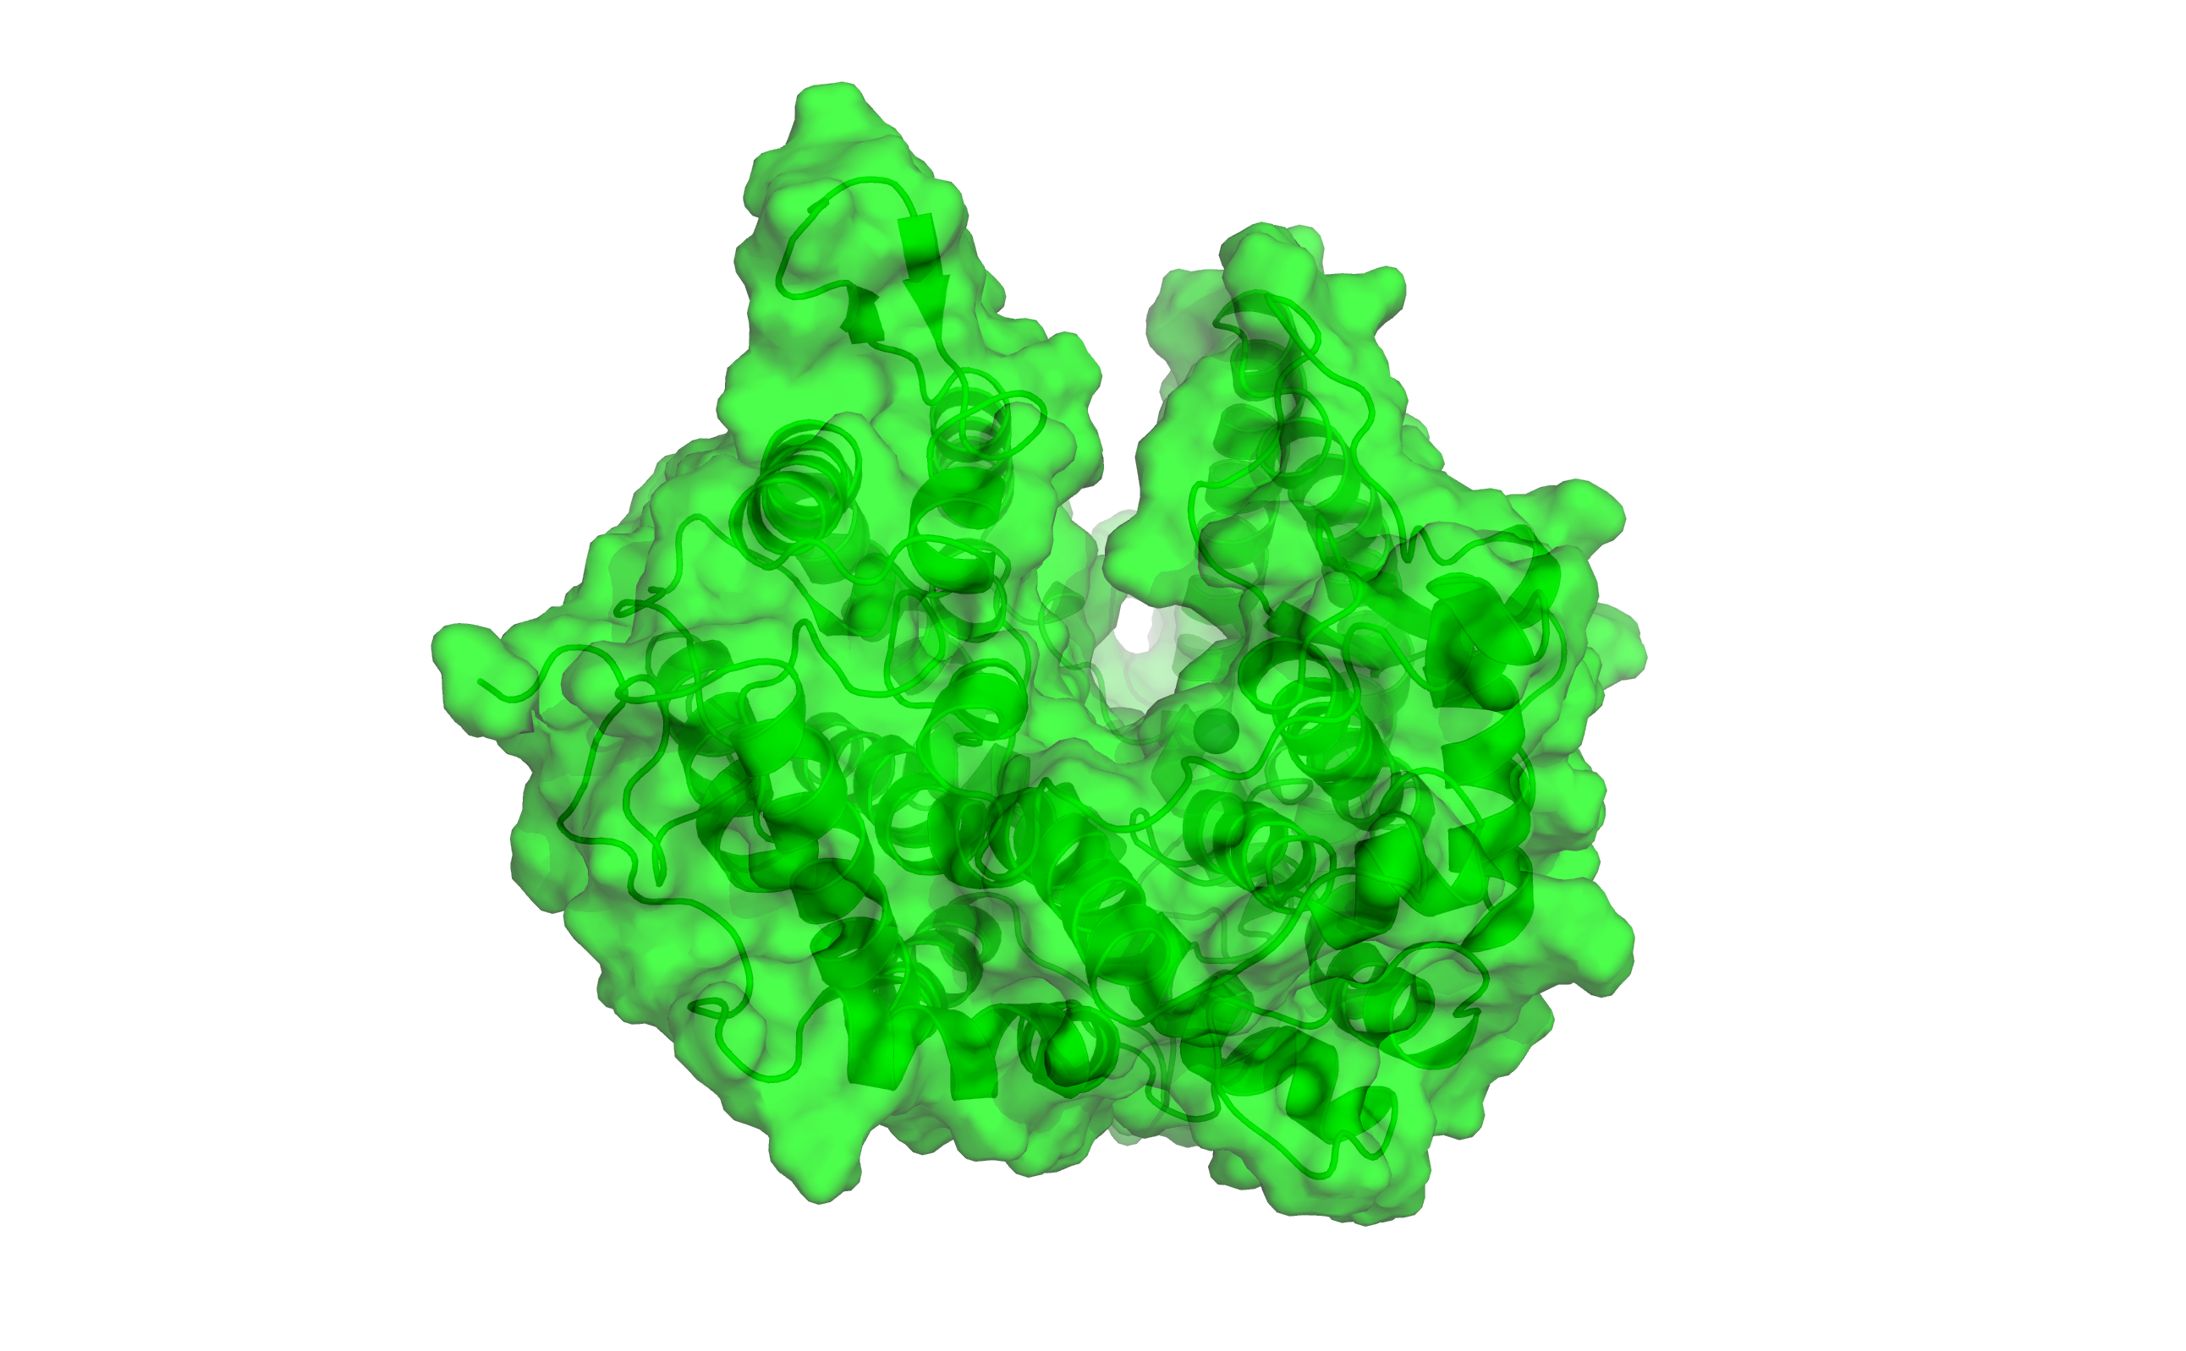
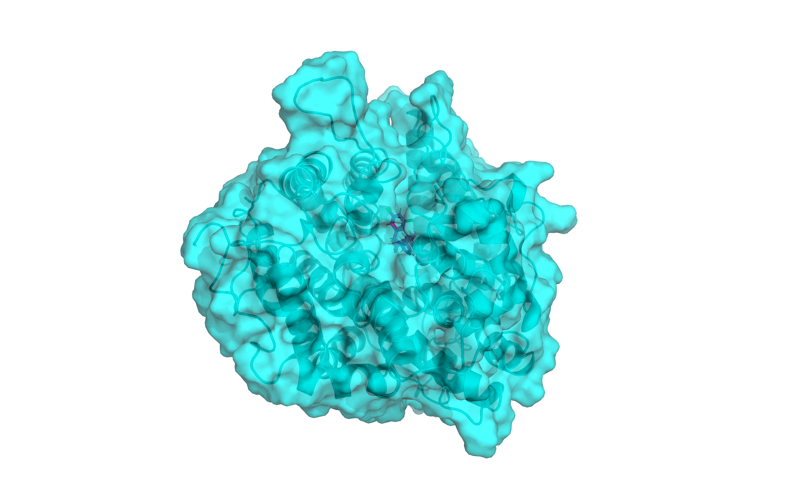
Conformational change upon ligand binding
ACE-2
Apo (ligand-free)
Holo (ligand-bound)

Slide 5
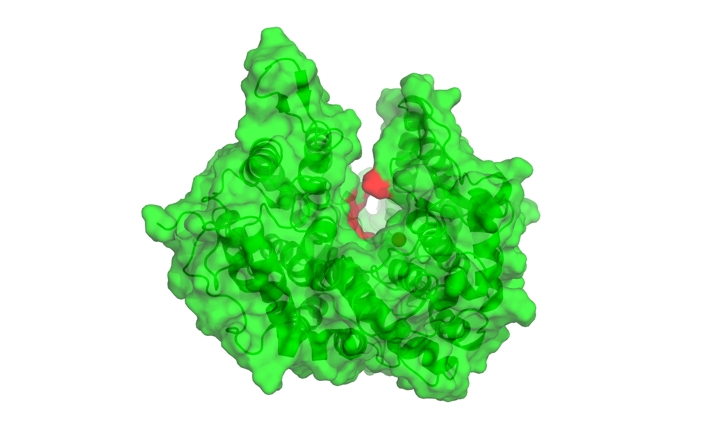

Conformational change upon ligand binding
ACE-2
Apo (ligand-free)
Holo (ligand-bound)

Slide 6
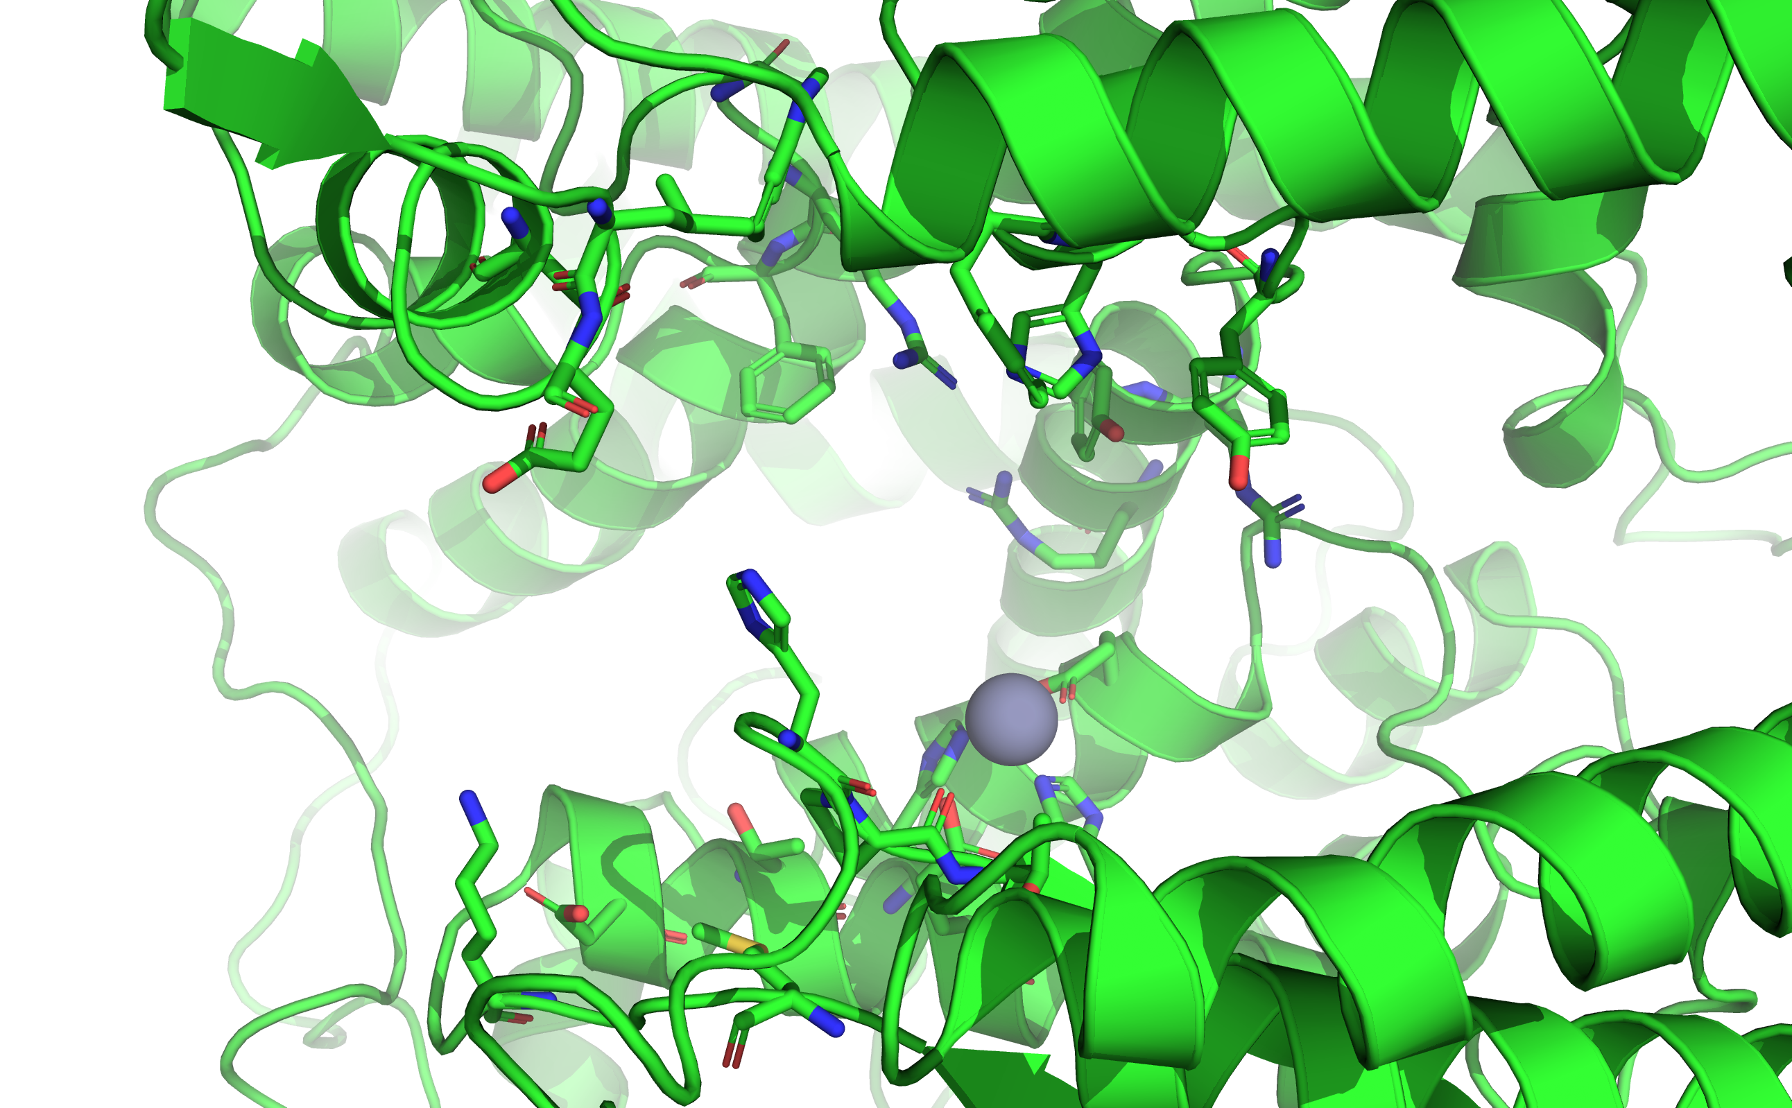
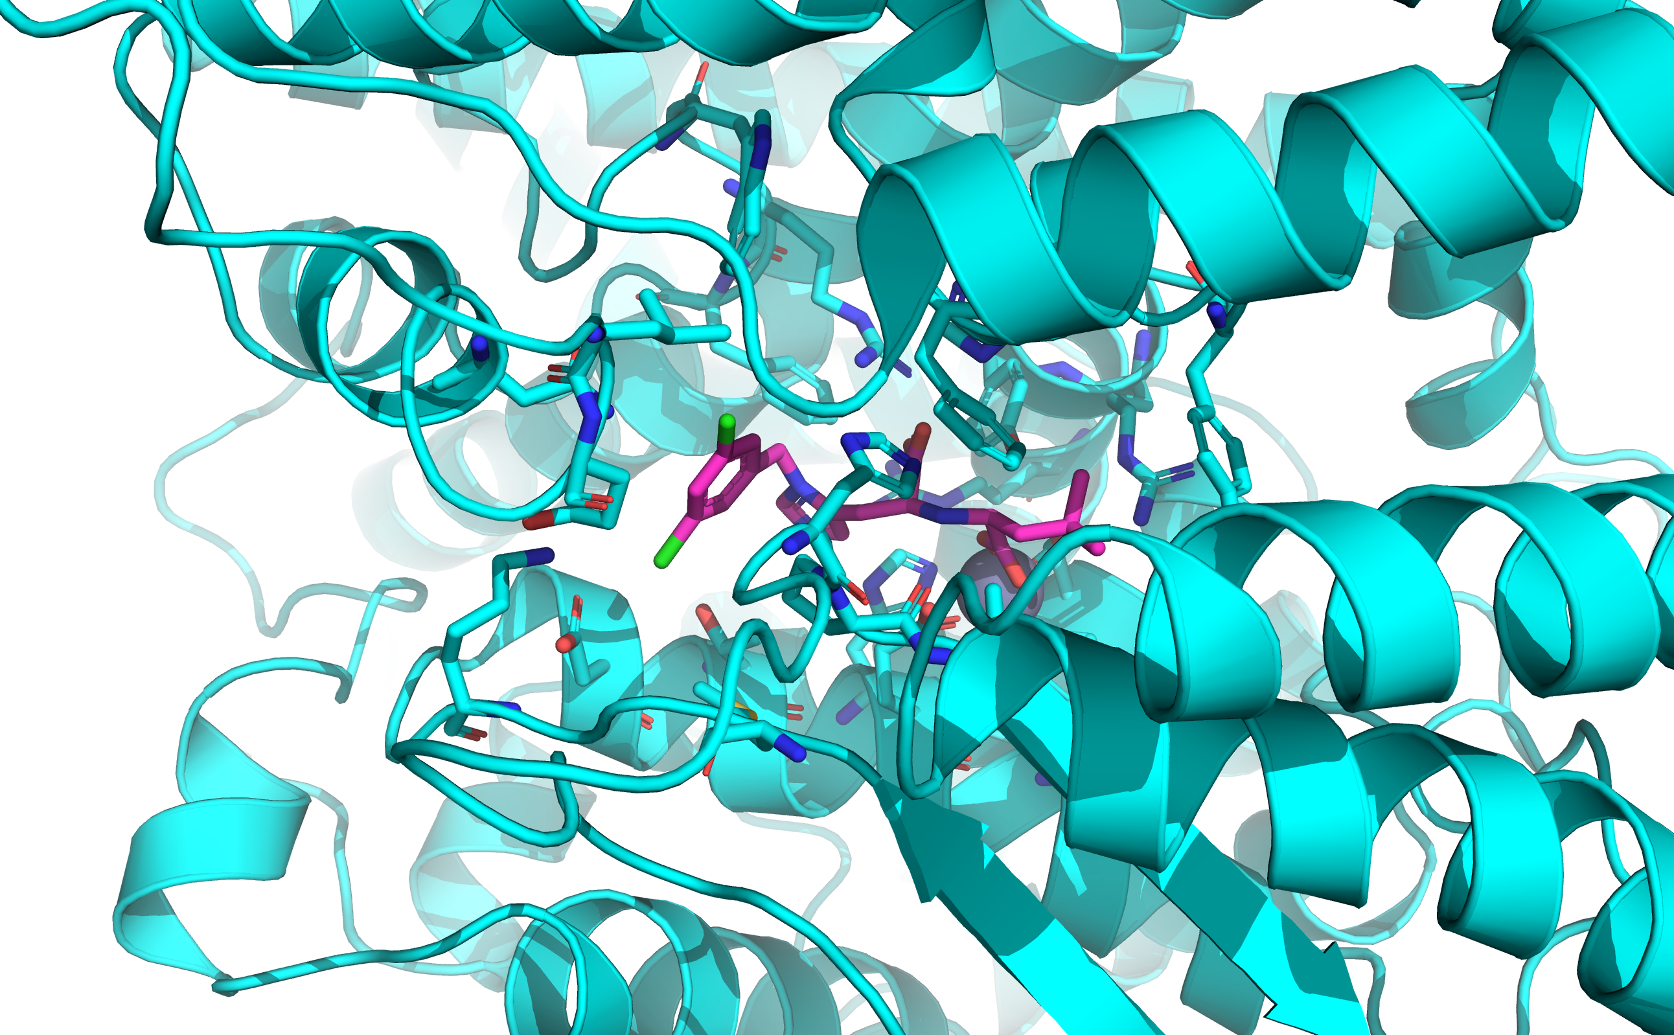
ACE-2 ligand binding site
Ligand binding residues:
Residues with heavy atoms within 5A of the ligand in the holo simulation starting structure

Slide 7
RMSF
Root mean square fluctuation
Align each simulation frame
Calculate mean position of each atom over the course of simulation
Calculate square displacement from mean in each frame
Average the square displacements and take the square root
Gives an estimate of how flexible atom positions are

Slide 8
Testing the hypothesis
Hypothesis in terms of RMSF:
Atoms in ligand-binding residues have lower RMSFs in holo trajectories compared with apo trajectories.
Notes:
To rephrase the hypothesis in terms of RMSF

Slide 9
Software
PyMOL used to convert .mae topology files to .pdb format
MDTraj trajectory analysis library was used to load and process trajectories
RMSF calculation via mdtraj.rmsf
Jupyter notebooks
Could be converted into a general tool to compare binding site RMSF in paired apo-holo simulations

Slide 10
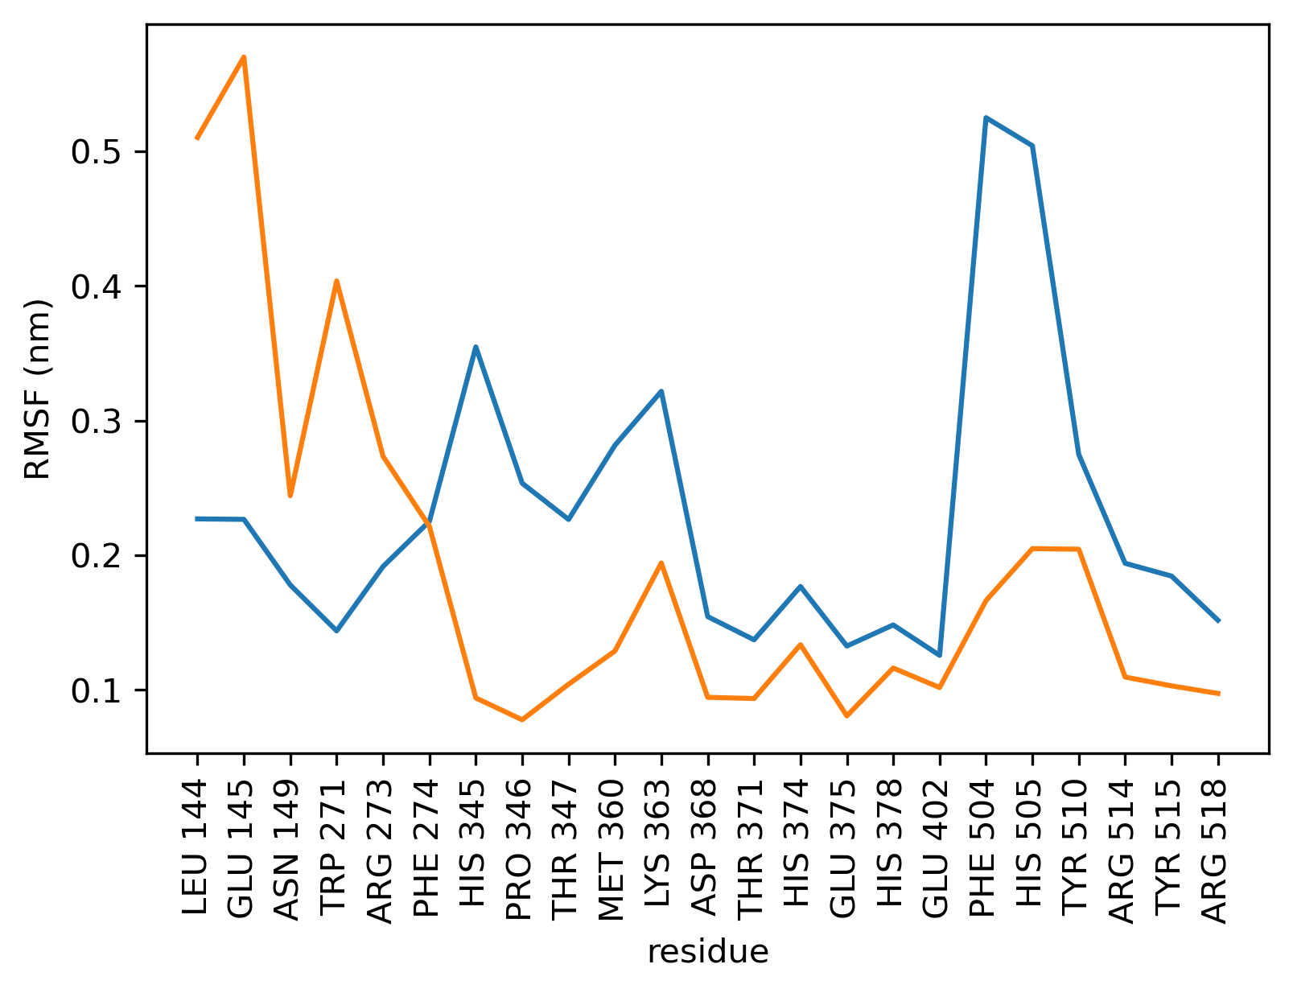
Results: binding-site RMSF by residue
Holo
Apo

Slide 11
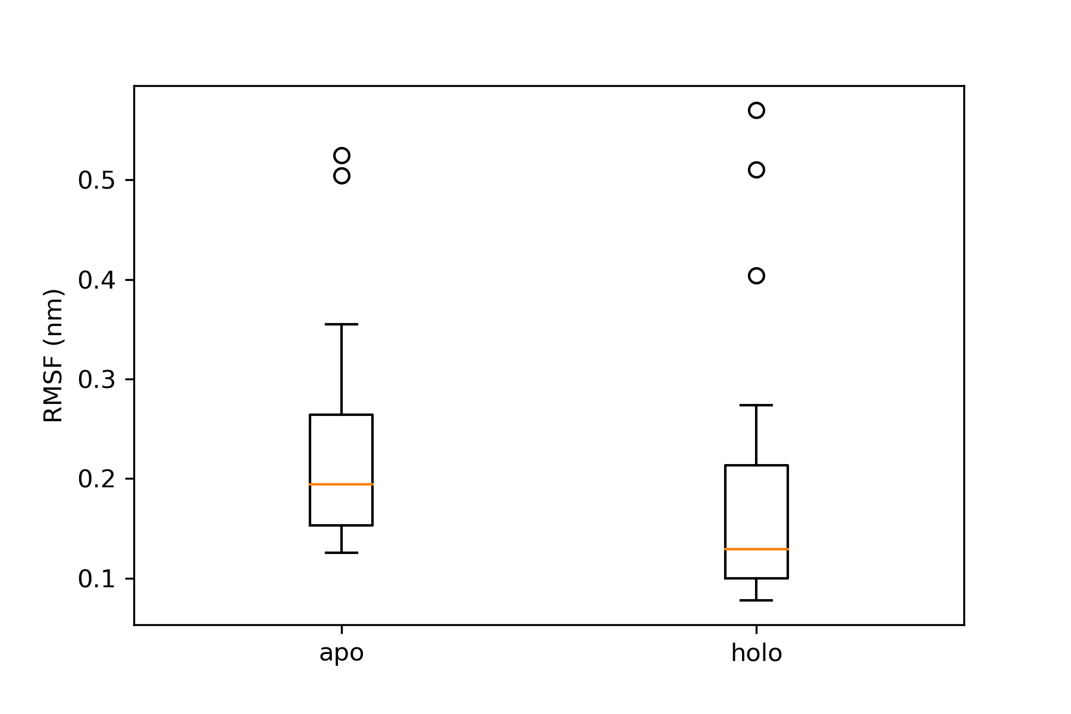
Results: ligand-lining residue RMSF
23 ligand-lining residues*
Difference is statistically insignificant at alpha = 0.05
*RMSFs were averaged across the atoms in each residue. Counting each atom individually is wrong because they don’t all move independently and thus aren’t independent observations. A more advanced approach might count rotatable bonds
The data do not reject the null hypothesis of equal RMSF
Notes:
Question for audience: What would independent observations be in this case? ←→ how many observations do I have?

Slide 12
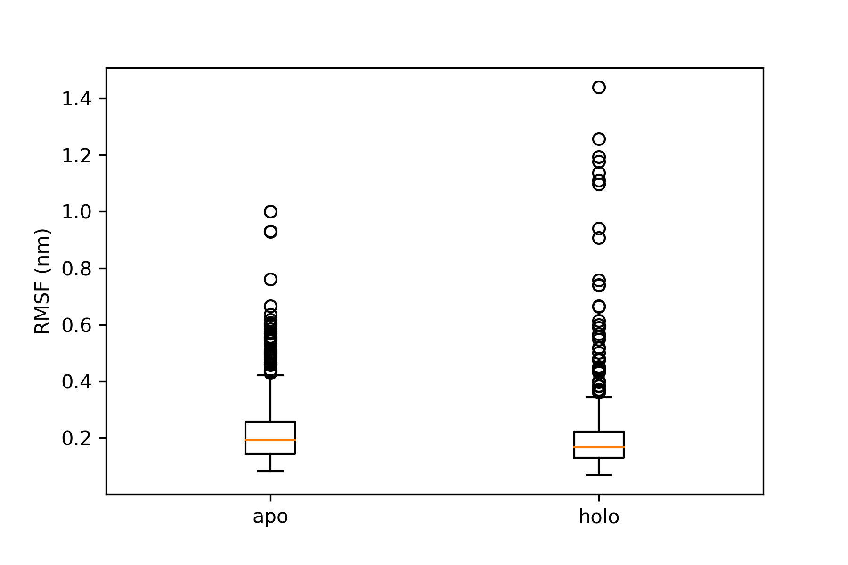
Comparison of non-ligand-lining residues
577 non-ligand-lining residues*
Difference is statistically significant at alpha = 0.05
*many of these are bound into alpha-helices, so the actual number of residues which move independently [with a low energy barrier] is lower
Very small difference in RMSF
Actual significance unclear due to observation non-independence
Notes:
Question for audience: What would independent observations be in this case? ←→ how many observations do I have?
Greater flexibility of non-ligand-lining residues is inconsistent with published work analyzing PDB structure flexibility based on b-factors

Slide 13
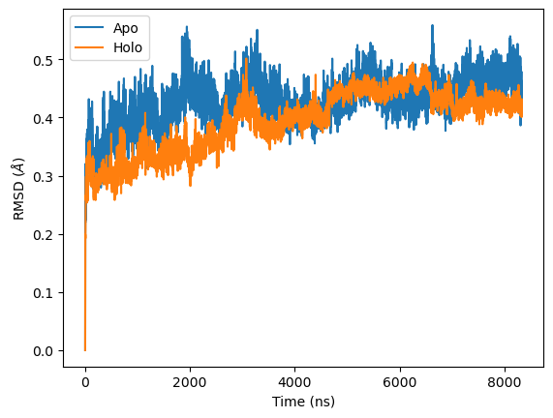

Change in RMSD with ligand binding
RMSD computed with respect to first frame of trajectory
Overall smaller magnitude RMSD in ligand-bound trajectory, but doesn’t look decisive

Slide 14
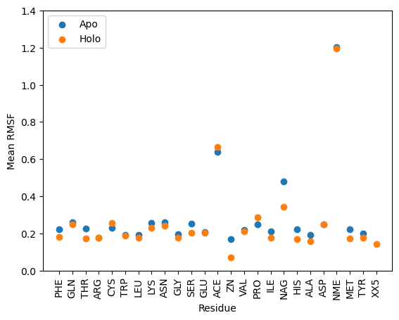
RMSF per residue
Non-amino acid residues have highest RMSF
Overall decrease in residue’s RMSF after binding of ligand

Slide 15
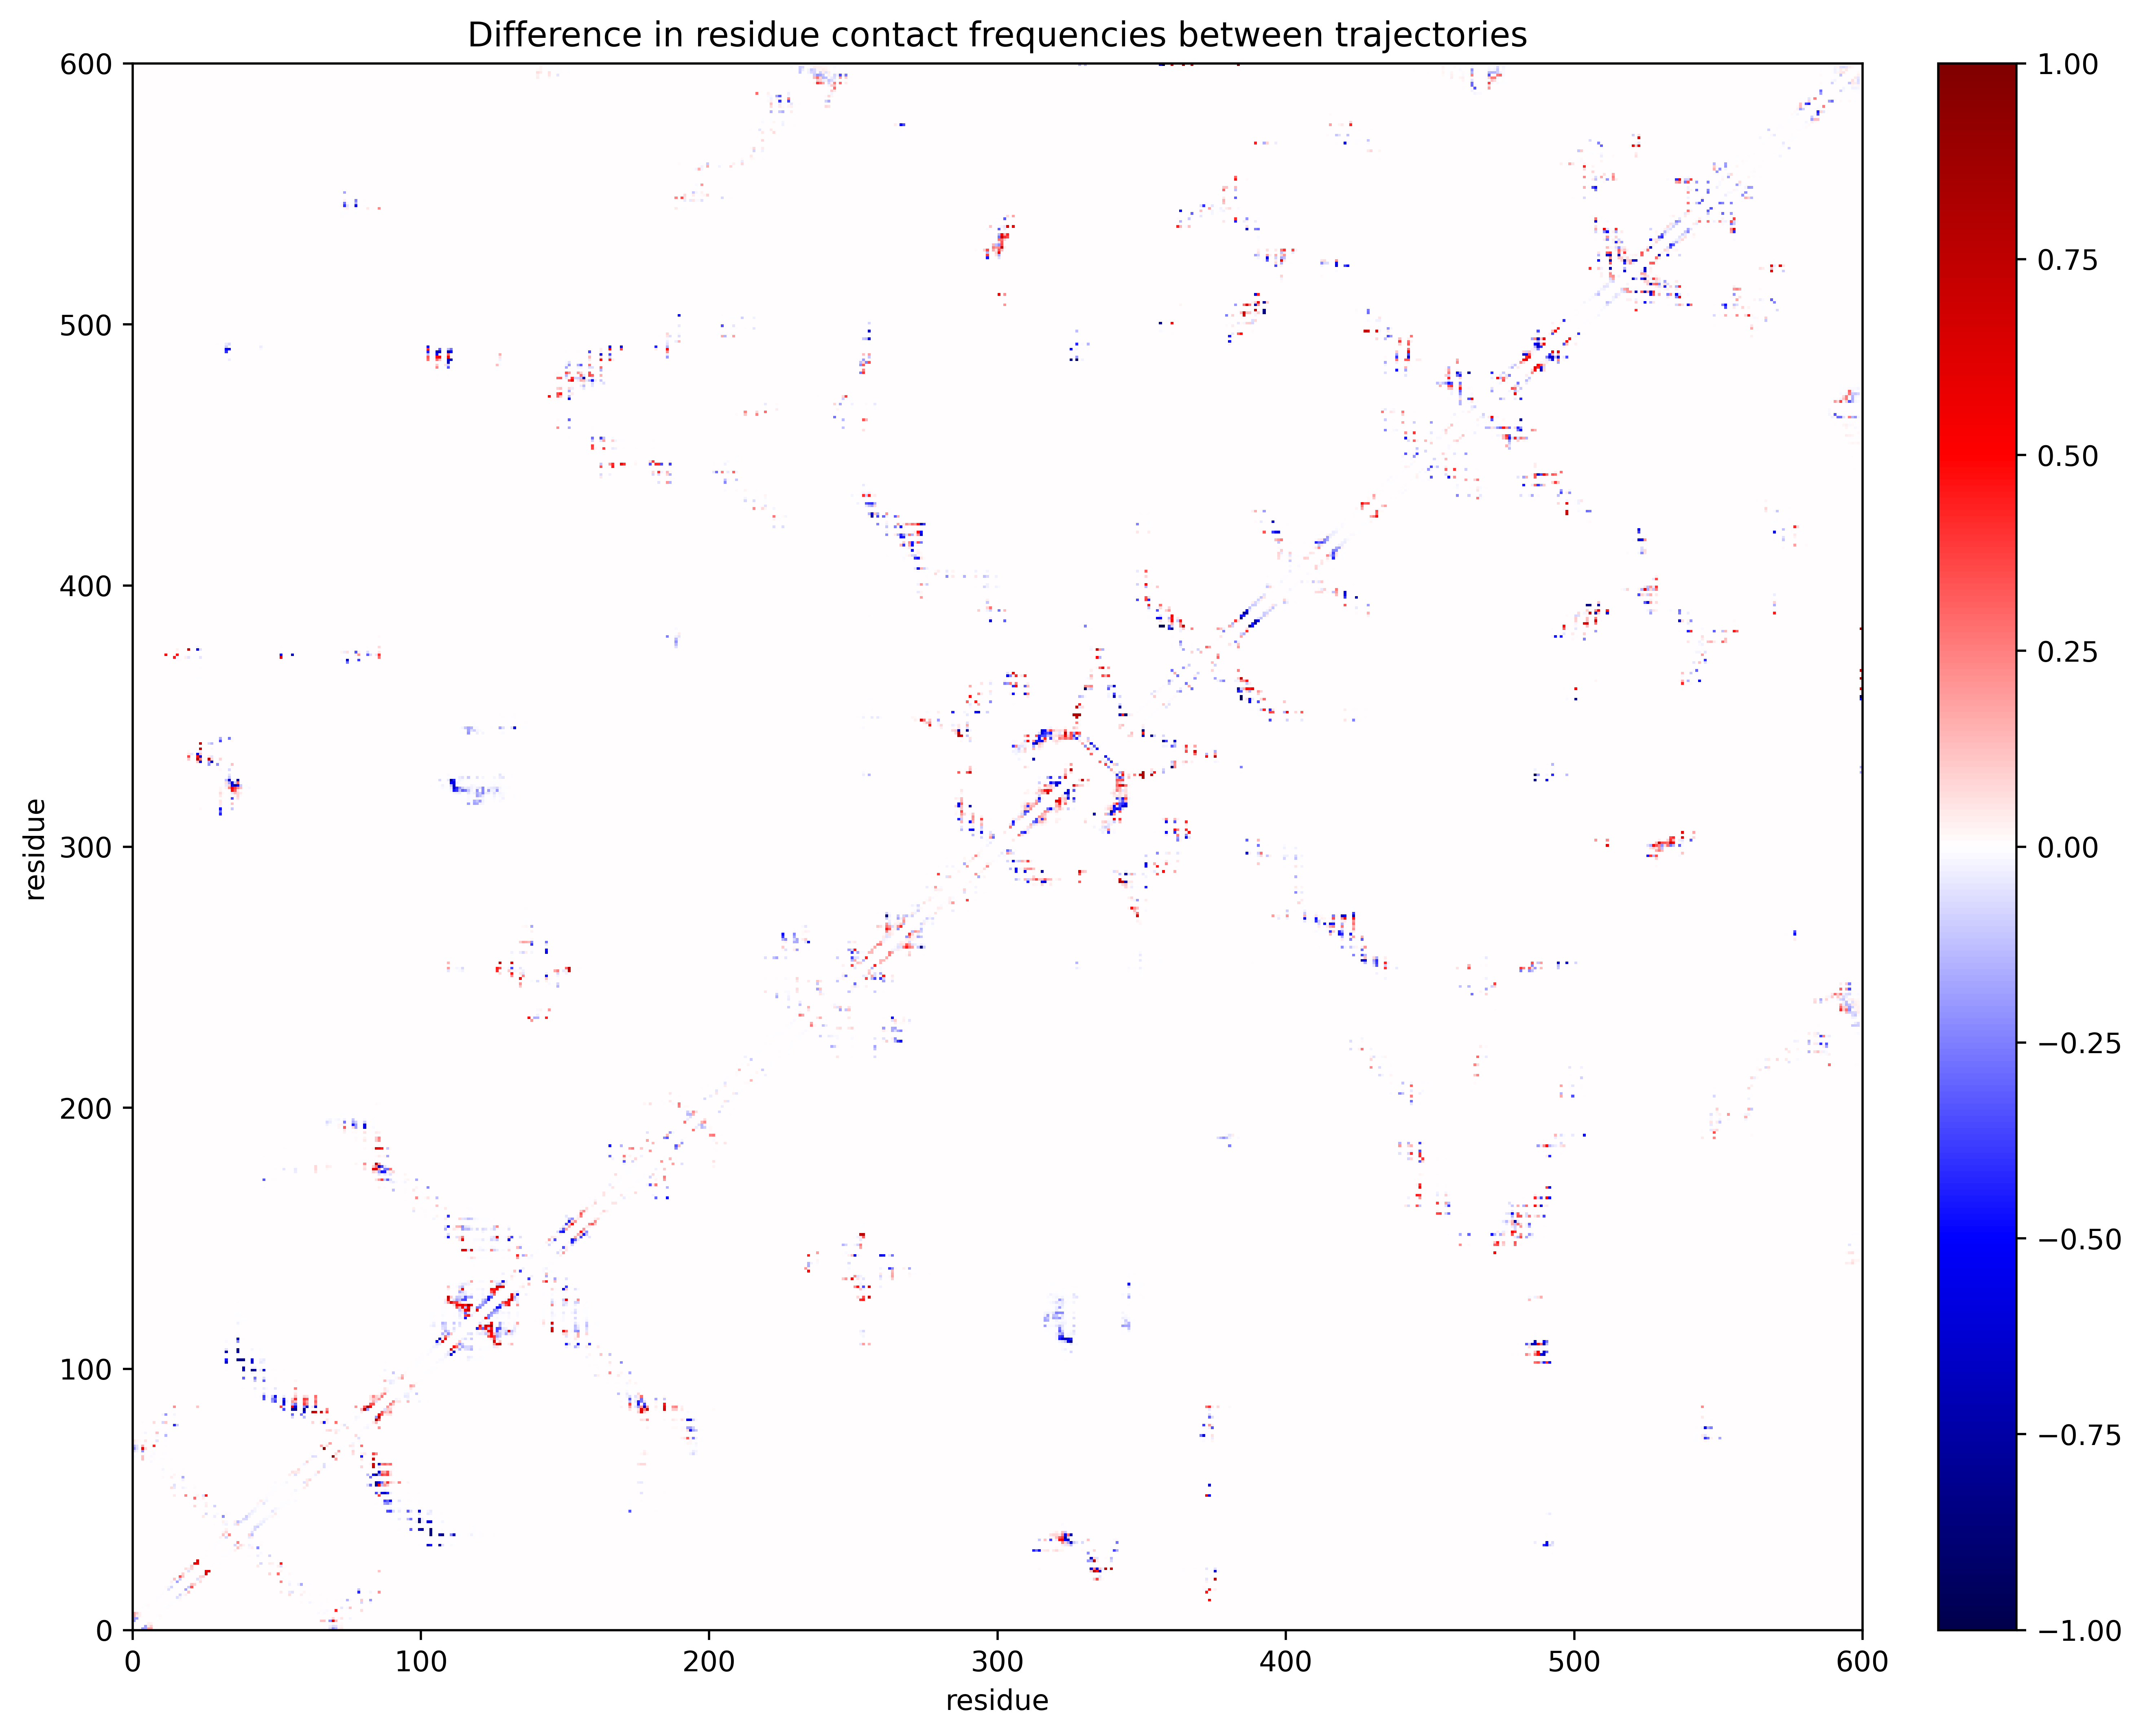
Change in contact frequencies

Slide 16
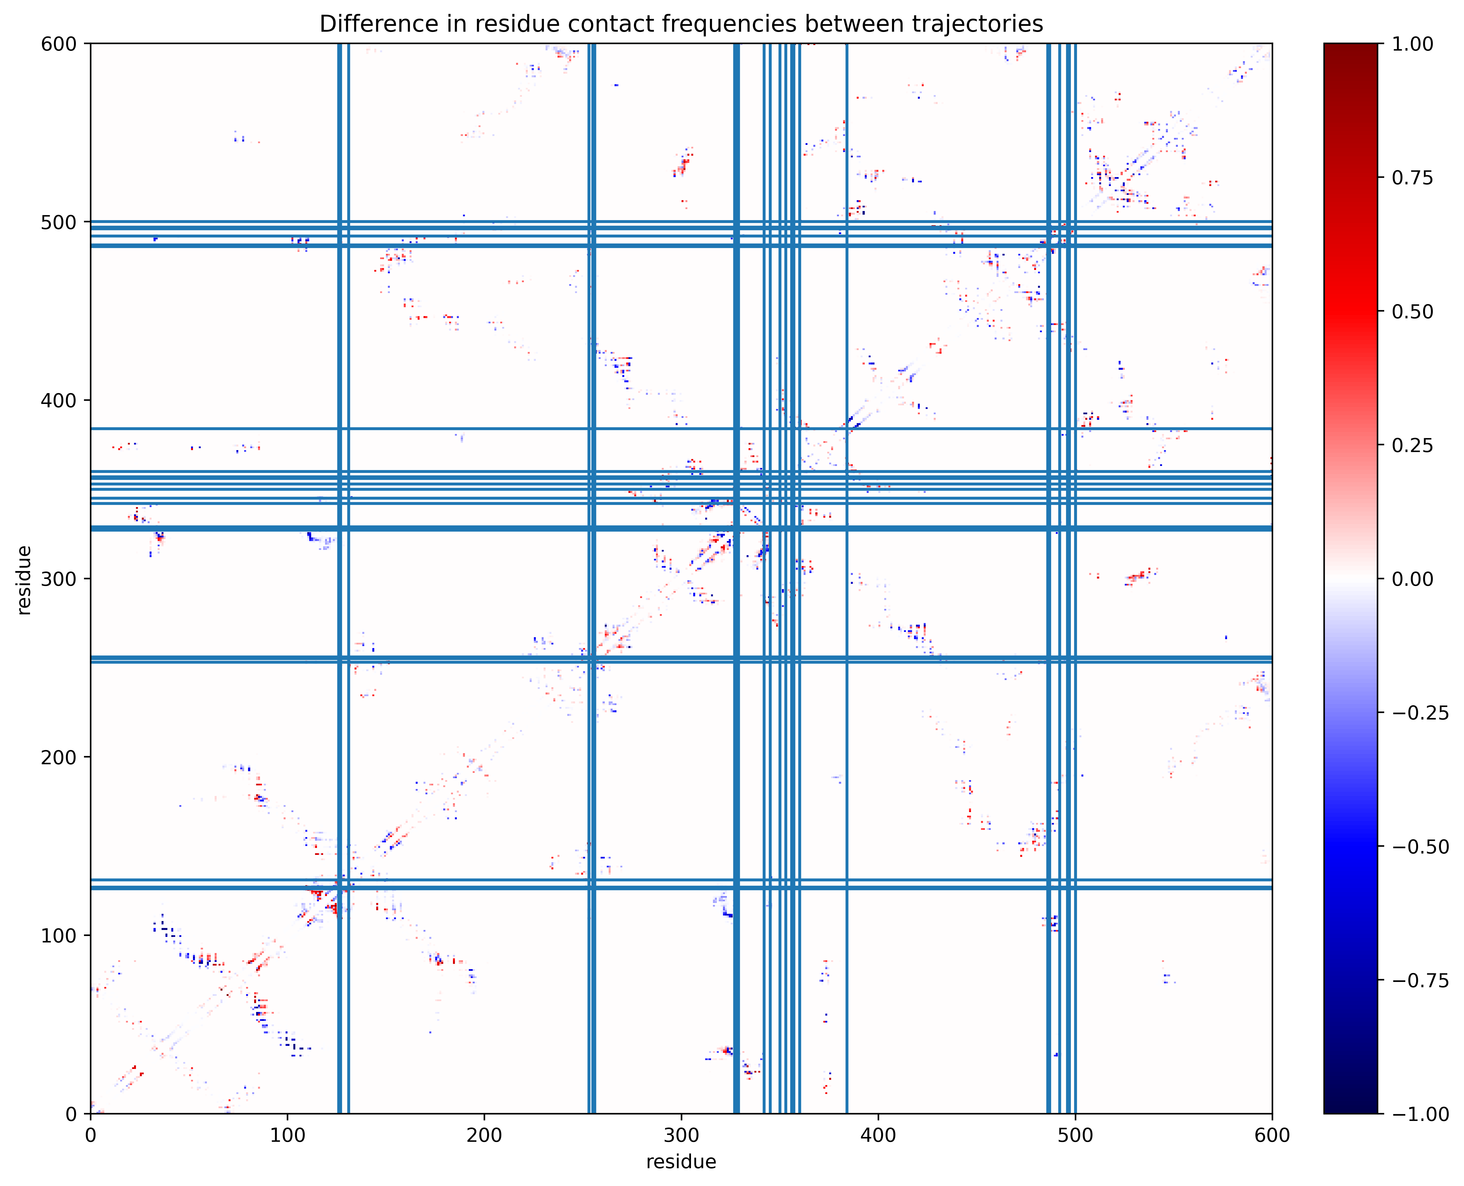
Change in contact frequencies
Ligand binding residues

Slide 17
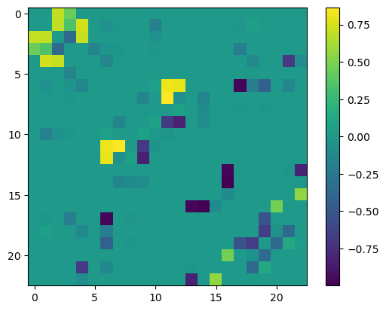
Change in contact frequency after ligand binding
More contact in apo
More contact in holo

Slide 18
Change in contact frequency after ligand binding
More contact in apo
HIS <-> ASP
HIS <-> THR
PRO <-> ASP
HIS <-> GLU
GLU <-> GLU
(+) charged amino acids
(-) charged amino acids
Polar uncharged

Slide 20
Bibliography
D. E. Shaw Research, "Molecular Dynamics Simulations Related to SARS-CoV-2," D. E. Shaw Research Technical Data, 2020. https://www.deshawresearch.com/downloads/download_trajectory_sarscov2.cgi/

